Slide 1

Same-Q
QUESTIONS PAIRED, KNOWLEDGE SHARED
Midway Milestone Presentation: CS 147 Assignment 8

Slide 2
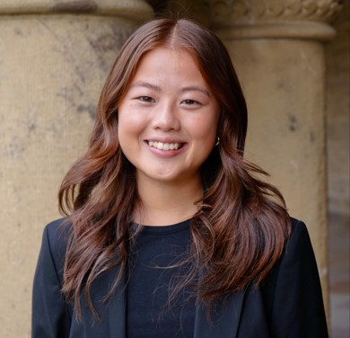


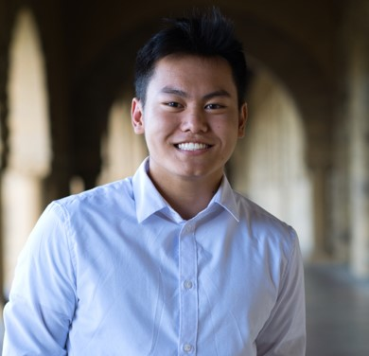
Team Same-Q
Jailia Yang
Seamus Allen
Fred Urech
Ashton Xiong

Slide 3
Value Proposition
Elevate office hours: match questions, connect students, and share knowledge.

Slide 4
Problem:
Solution:
Students wait in the queue, enduring the repetitive cycle of Teachers and TA’s answering the same questions.
Group students together with the same question to enable collaboration and make waiting for Teacher/TA assistance productive.

Slide 5
OVERVIEW
1
Heuristic Evaluation Results
2
Revised Design
3
Prototype Status
4
Demo

Slide 6
Heuristic Evaluation Result
Category | # Viol. (sev 0) | # Viol. (sev 1) | # Viol. (sev 2) | # Viol. (sev 3) | # Viol. (sev 4) | # Viol. (total)
H1: Visibility of Status |  | 2 | 1 | 1 |  | 4
H2: Match Sys & World |  | 2 | 2 | 1 | 1 | 6
H3: User Control |  | 2 | 4 | 1 |  | 7
H4: Consistency & Standards | 1 | 4 | 5 | 1 | 1 | 12
H5: Error Prevention |  | 2 | 2 | 3 |  | 7
H6: Recognition not Recall |  |  | 2 |  |  | 2
H7: Efficiency of Use | 1 | 2 | 2 | 1 | 2 | 8
H8: Minimalist Design |  | 5 | 2 |  |  | 7
H9: Help Users with Errors |  | 1 |  |  |  | 1
H10: Help & Documentation |  |  | 1 | 2 |  | 3
H11: Accessible |  | 5 |  | 1 |  | 6
H12: Value Alignment & Inclusion |  |  | 1 |  | 1 | 2
Total Violations by Severity | 2 | 25 | 22 | 11 | 5 | 65
Summary Results:
Total Number of Heuristics Broken: 65
Number of Heuristics 0 - 2 Severity: 49
Number of Heuristics 3 - 4 Severity: 16

Slide 7
Severity 0-2 Changes
49 Total Implications
Change #1: H11 Accessible Design
Change: Changed Purple to be more muted. More light and less strong purple.
Rationale: Feedback from users indicated that the initial color choice was excessively bright, posing challenges for individuals with color blindness. In response to this insight, adjustments are deemed necessary to enhance accessibility and ensure a more user-friendly experience for all.
Change #2: H11 Accessible Design
Change: Increased Text size that scales to device dimensions
Rationale: Users expressed that Question descriptions in list of queue as well as text when creating a question or in the huddle description are very small.
Change #3: H7 Flexibility & Efficiency of Use
Change: More intentional Information and cut repeated information from prototype (e.g. Join with “X” others)
Rationale: We examined the app and cut any information that was repetitive. This allowed us to free up areas with text and have icons and numbers give the user information.

Slide 8
Severity 0-2 Changes
Change #1: H11 Accessible Design
Insight: Users indicated that the initial color choice was excessively bright, posing challenges for individuals with color blindness
Change: Changed Purple to be more muted. More light and less strong purple
Change #2: H11 Accessible Design
Insight: Users expressed that Question descriptions in list of queue as well as text when creating a question are very small
Change: Increased Text size that scales to device dimensions
Change #3: H7 Flexibility & Efficiency of Use
Insight: Interface felt busy, bit difficult to navigate and find what people are looking for in light of a lot of text and information
Change: More intentional Information, cut repeated information from prototype (e.g. Join with “X” others), freed up text and have icons and numbers inform users instead
Notes:
Change 1: [Read insight]. In response to this insight, adjustments are deemed necessary to enhance accessibility and ensure a more user-friendly experience for all.
Change 2: [Read insight], …and the same comment was made about messages the huddle page, specifically the description.

Slide 9
Severity 3-4 Change Summary
Change #1:
H7 Flexibility and Efficiency of Use
Change: Better Navigation. User no longer is prompted with the option of writing a question, but rather free to browse a class’s queue. Has the option of adding a question later
Rationale: This step was repetitive in the app’s navigation. A user could join the app to solely join similar questions. Instead, a user has the freedom of choosing to make a question instead of denying the question prompt before joining a class.
Change #2:
H3 User control and freedom
H7 Flexibility and Efficiency of Use
Change: Giving the user ability to “Un-Collaborate”. A user would join a questions and automatically get that question stored as “collaborated”. User can now choose to un-collaborate on specific questions.
Rationale: The user can “un-collaborate” on questions for many different reasons such as the question being resolved, they no longer need it, or it takes up space. This give the user freedom and control over their app.
Change #3:
H8 Aesthetic & Minimalist Design
Change: Icons were more intentional
Rationale: initially had a lot of icons that were similar or confusing without additional documentation. Made sure that icons are now used for the same purpose across the screens, and that icons are different enough to not be confused with one another

Slide 10
Severity 3-4 Changes
Change #1: H7 Flexibility and Efficiency of Use
Insight: More flexible navigation is needed. Give user the freedom of choosing to make a question instead of denying the question prompt before joining a class
Change: Better Navigation. User no longer is prompted to write a question, but rather free to browse queue, can add a question later
Change #2: H9 Recover from Errors/H7 Flexibility and Efficiency of Use
Insight: Option needed to “un-collaborate” on questions, can happen for many different reasons such as a mistake, the question being resolved, they no longer need it, or it takes up space
Change: Adding ability to “Un-Collaborate”. User can now choose to un-collaborate on specific questions, giving them more choice
Change #3: H5 Error Prevention
Insight: A lot of icons that are similar and thus confusing without additional documentation
Change: Icons are now used for the same purpose across the screens, and icons are more distinguishable/hard to be confused
Notes:
Change 1: [Read insight]. In response to this insight, adjustments are deemed necessary to enhance accessibility and ensure a more user-friendly experience for all.
Change 2: [Read insight], …and the same comment was made about messages the huddle page, specifically the description.

Slide 11
Progress Towards Usability Goals
Efficiency
Better Navigation allows the user to better traverse the app without feeling lost and confused.
The back button is now labeled with the previous page the user was on.
The page header at the top of each page that allows the user to know current location.
Collaboration Tab Allows for efficient search when looking for previously visited questions.
Invitingness
Intentional Icons and Numbers invite the user to join instead of having words that may be daunting for users.

Slide 12
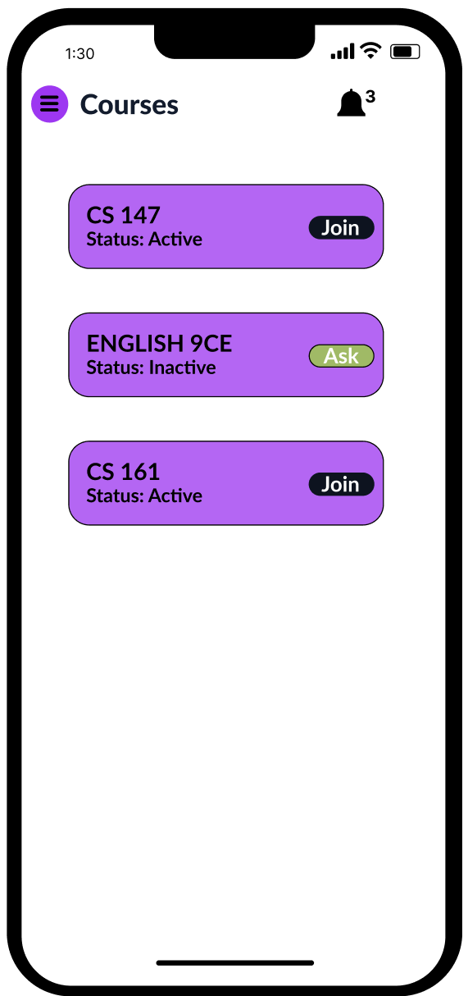
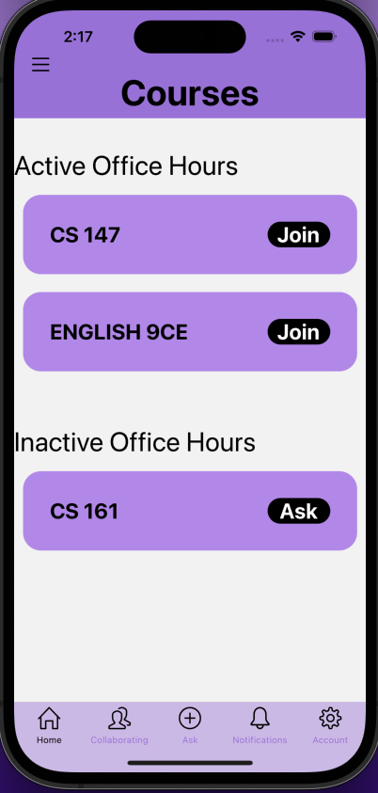
Overview of Revised Design
#1: Home Page and Navigation
Revisions
Made Buttons/Classes Larger and Closer. Adhered to Fitts Law with button size.
Grouped Similar action items together and kept opposing items apart (Active/Inactive Classes)
Added a bottom Bar for easier navigation and accessibility
Before
After

Slide 13
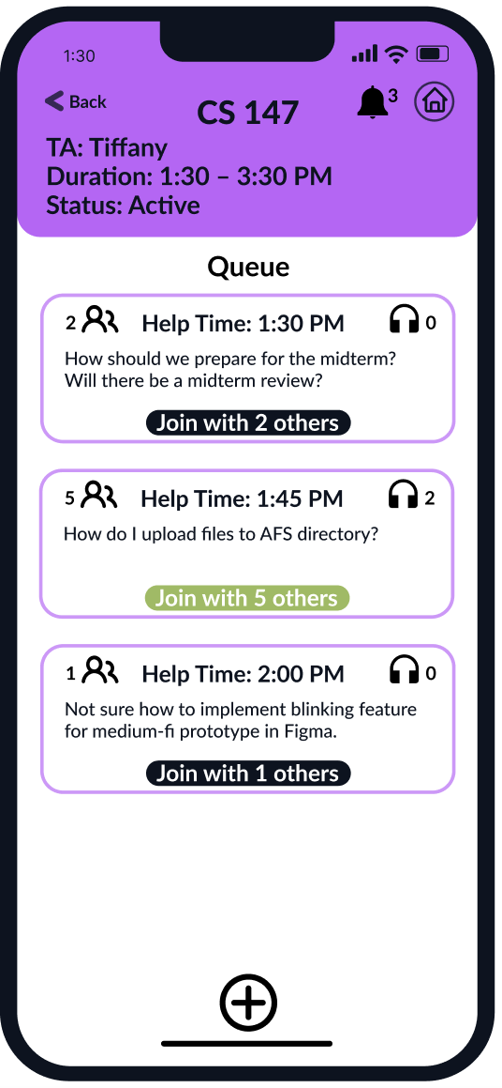
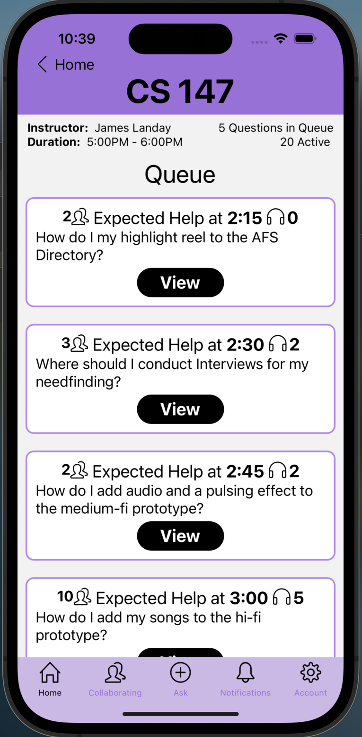
Overview of Revised Design
#2: Remove Repetitive Information
Revisions
Changed “Join with X Others” to view. This lets the user know there is a distinction between joining a classes OH, and viewing a question together where they can choose to collaborate later.
Removes Number of people in button because the active number of people is present in the top right of the button
Before
After

Slide 14
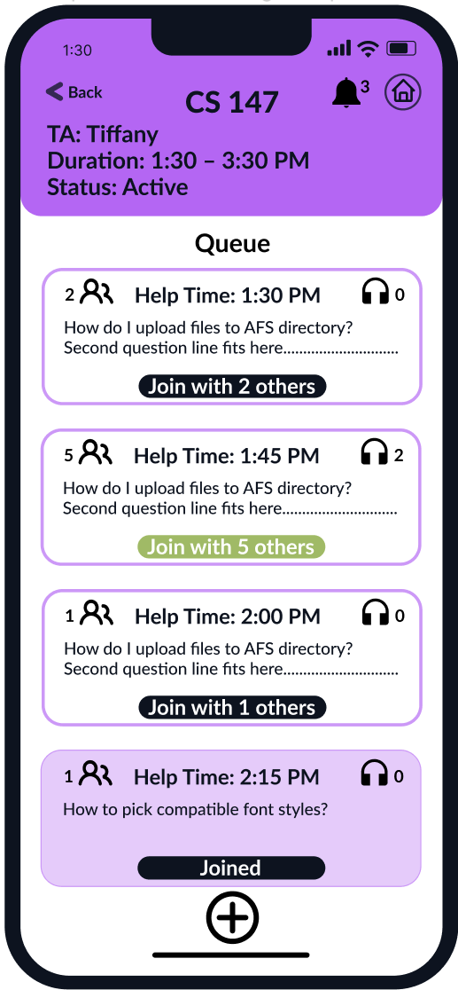
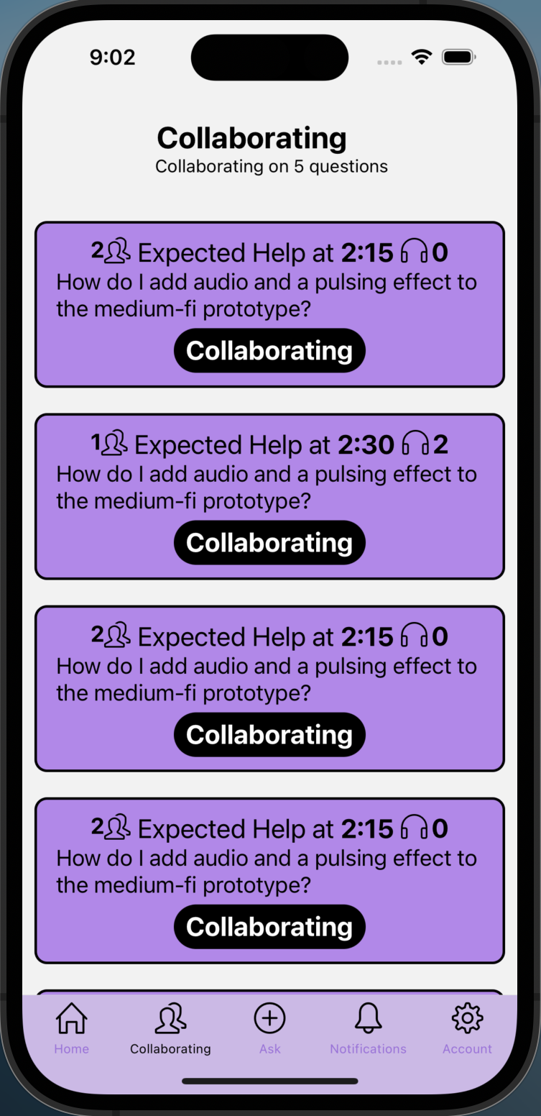
Overview of Revised Design
#3: Collaboration and System Visibility
Revisions
Added a new page to check for questions that the user is currently collaborating on
Gets rid of searching through queue for visited question
Clear distinction in color with “collaborated” and “un-collaborated”
Before
After

Slide 15



Prototype Status
Additional Resource:
React Native Libraries
FontAwesome
SimpleIcons
#1: Frameworks/Tools - Development Stack
Front-End Framework
Back-End
Collaboration/Source Control

Slide 16


Prototype Status
#2: Development Tools
VS Code
Expo GO

Slide 17
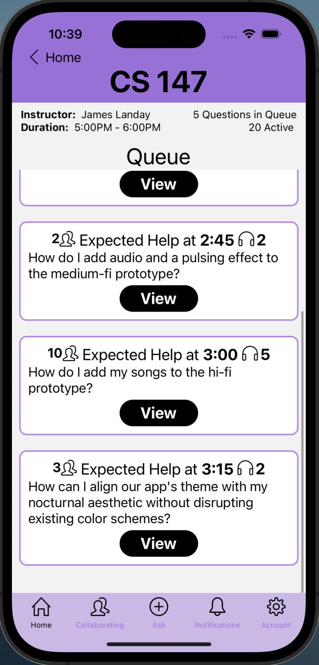
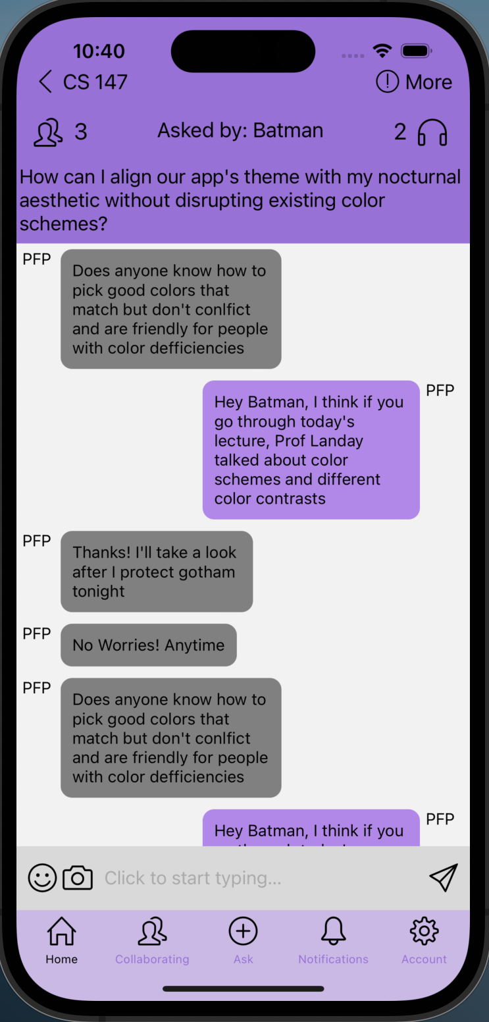
Implemented Task/Features
Task 1: Join a question in the queue
Swipe to explore questions

Slide 18
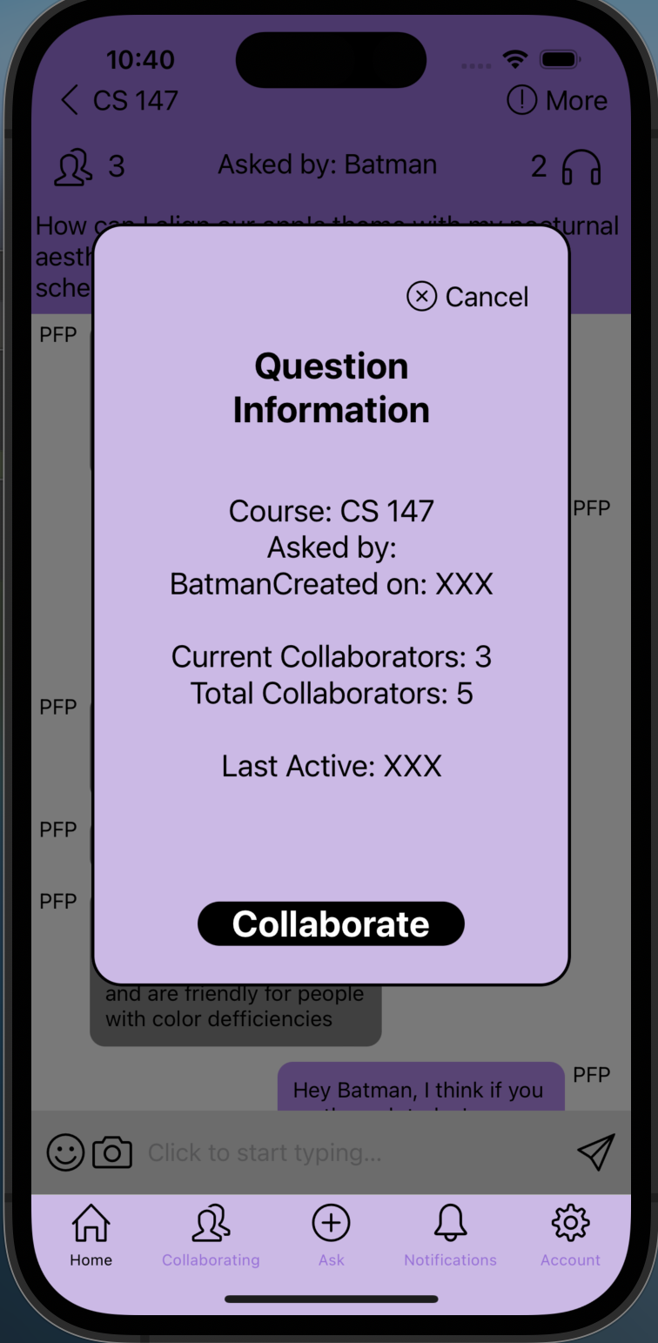
Implemented Task/Features
Task 1: Join a question in the queue

Slide 19
Implemented Features
Task 1: Join a question in the queue
Stack Navigation
The main stack allows for proper navigation between different pages
Back button allows user to move backwards from the direct previous page
Bottom bar tab navigation allows for easy navigation and maintains stack location (Home Button doesn’t automatically go home)
Scrolling
Allows for extensive data to be rendered and explorable in pages
Notifications
Users have a notification page that lets them know if another user is interacting with their own question or a collaborated question

Slide 20
UnImplemented Features
Other Pages In tasks 2/3
Pages not built for “asking a question”
Account Page needs to be added
Other question pages (CS 161, English 9CE) need to be populated with different data
Messaging
Messaging feature is not functioning and only brings up the phone’s keyboard
Other
No form of data retention that can be used for saved questions, collaborated questions, questions asked. Need a small backend database
Hamburger Menu not yet functional
Account Information
Information/Help Page
Filtering Questions

Slide 21
Hard Coded Data/Wizard of Oz
Current Task 1
Each Question in all the courses has hardcoded data for CS 147 specifically
The information passed into each question in the queue is used with hardcoded props.
Messaging
All Messages for all classes are currently hard coded for one specific question in the queue
Other
The notification page in the bottom bar is hardcoded in the front-end to fake notifications
Collaboration page in the bottom bar is hardcoded to render a list of current questions the user has collaborated on.

Slide 22
Plans to Finish
Start Task 3: Make Pages for Voice Huddles and Pop-ups
Finish Miscellanous Items, Extra feature
Start Task 2: Make pages for asking questions.
Make Voice Huddle Functional
Finish Task 2
Make question persist in database
Create Back-End Database
Make Messaging functional
Finish Task 3

Slide 23
High-Fidelity Prototype Task 1 Demonstration

Slide 24
Thank You!

